Slide 1

Rust Overflow
How to build functional Web Apps using a Diesel powered Rocket
Rust-Saar Meetup - 08.03.2022
Florian Kohn

Slide 2
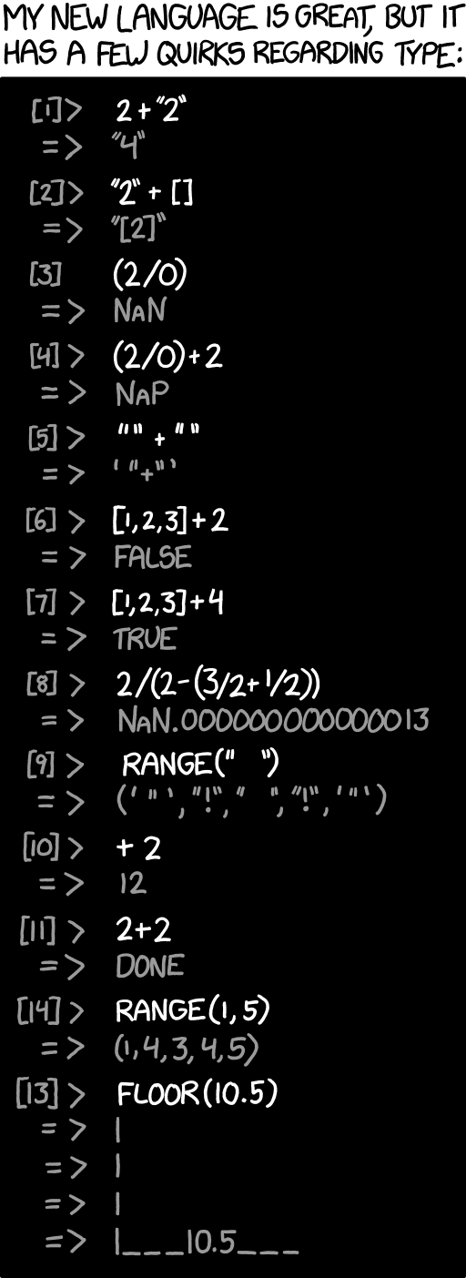
Why build Web Apps with Rust?

Slide 3



Why build Web Apps with Rust?
"user": „John Doe"
"user":{"$func": "var_dump"}
Dumps all variables to output if the type of the user parameter is not checked. Related CVE: (CVE-2020-35846)
Static Type analysis to the rescue!

Slide 4


How to build Web Apps with Rust?
Warp
Notes:
They all have their pros and cons
Actix
Confusing Docs
Some Boilerplate required
Warp
Not that mature
Rocket
No Websockets
Only one maintainer
But
Great Documentation
Ease of use

Slide 5



Overview
SQLite
Frontend
Backend
HTML

Slide 6
Overview
SQLite
Frontend
Backend
HTML

Slide 7
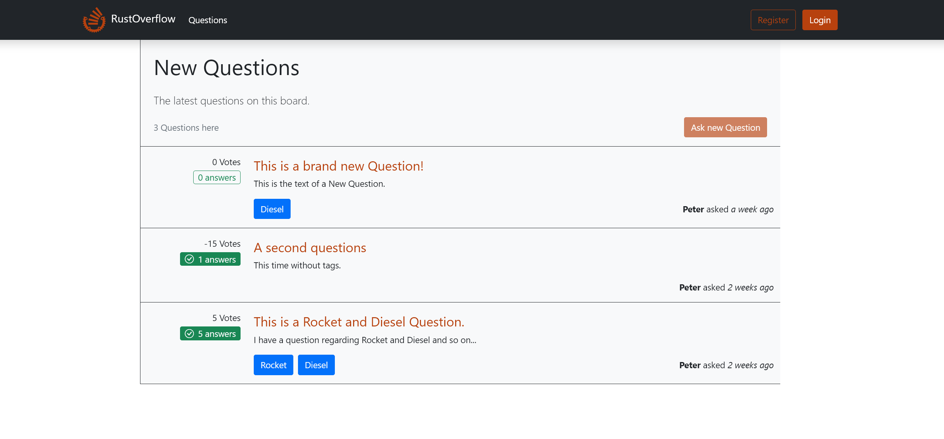
Target Acquired

Slide 8
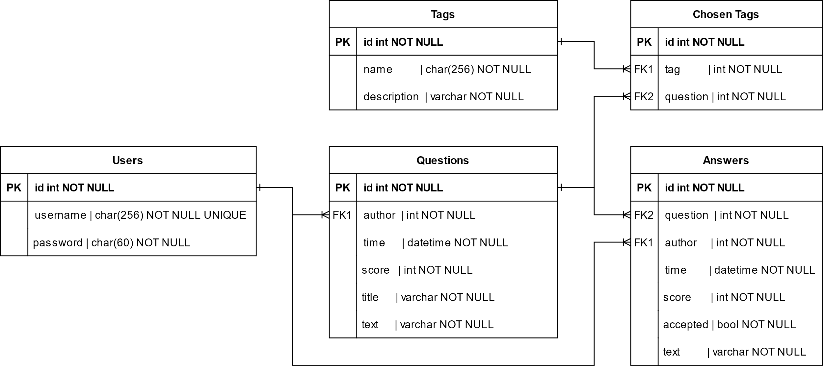
The database Layout

Slide 9
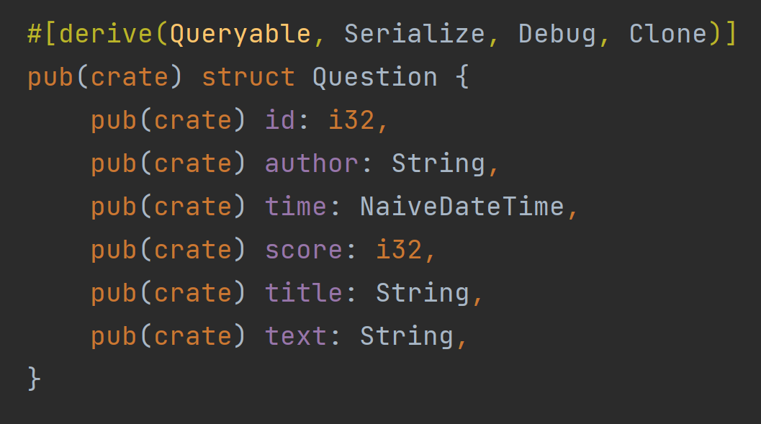
Power it with Diesel
DB Module
schema.rs
models.rs

Slide 10
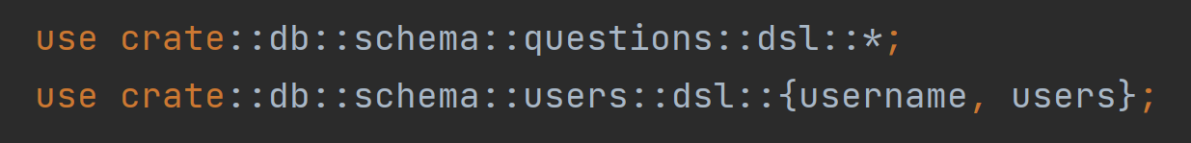
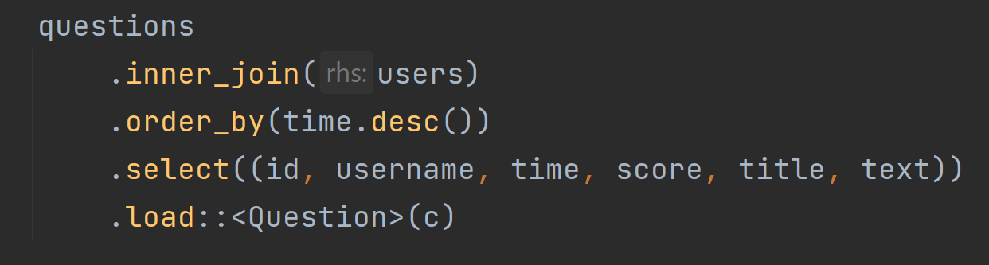
Power it with Diesel
DB Module
schema.rs
models.rs
actions.rs
Diesel Demo

Slide 11
Overview
SQLite
Frontend
Backend
HTML

Slide 12
Overview
SQLite
Frontend
Backend
HTML

Slide 13
No Rocket Science required
A module tree
Main Module
main.rs
frontend.rs
backend.rs

Slide 14
No Rocket Science required
A typical Rocket Handler - Backend
#[post(“/answer”, data = “<answer>”)] pub(crate) async fn answer_question(user: Login, conn: DbConn, answer: Form<AnswerForm>) -> Result<Redirect, (Status, String)>

Slide 15
No Rocket Science required
A typical Rocket Handler - Backend
Route
#[post(“/answer”, data = “<answer>”)] pub(crate) async fn answer_question(user: Login, conn: DbConn, answer: Form<AnswerForm>) -> Result<Redirect, (Status, String)>

Slide 16
No Rocket Science required
A typical Rocket Handler - Backend
#[post(“/answer”, data = “<answer>”)] pub(crate) async fn answer_question(user: Login, conn: DbConn, answer: Form<AnswerForm>) -> Result<Redirect, (Status, String)>
Guards

Slide 17
No Rocket Science required
A typical Rocket Handler - Backend
Response
#[post(“/answer”, data = “<answer>”)] pub(crate) async fn answer_question(user: Login, conn: DbConn, answer: Form<AnswerForm>) -> Result<Redirect, (Status, String)>

Slide 18
No Rocket Science required
Another Example - Frontend
#[get(“/q/<id>”)] pub(crate) async fn thread(id: i32, user: Option<Login>, conn: DbConn) -> Result<Template, (Status, String)>

Slide 19
No Rocket Science required
Another Example - Frontend
#[get(“/q/<id>”)] pub(crate) async fn thread(id: i32, user: Option<Login>, conn: DbConn) -> Result<Template, (Status, String)>

Slide 20
No Rocket Science required
Under the hood
#[post(“/answer”, data = “<answer>”)] pub(crate) async fn answer_question(user: Login, conn: DbConn, answer: Form<AnswerForm>) -> Result<Redirect, (Status, String)>
1
Validation
2
Processing
3
Response
Request Method must match
The path („/answer“) must match
The request must have data in its body
The data deserialize into an AnswerForm
The caller must be an authenticated user
The handler is run asynchronously
An HTTP response is generated from the handlers return value.
Many return types can be made into a response:
Jason<T> (Generates a Json response)
NamedFile (Serve a static file)
Stream (Stream data from a Read object)
Primitive Type: String, &str, File, Option, Result, etc.

Slide 21
Let‘s Launch a Login!

Slide 22
Overview
SQLite
Frontend
Backend
HTML

Slide 23
Overview
SQLite
Frontend
Backend
HTML

Slide 24
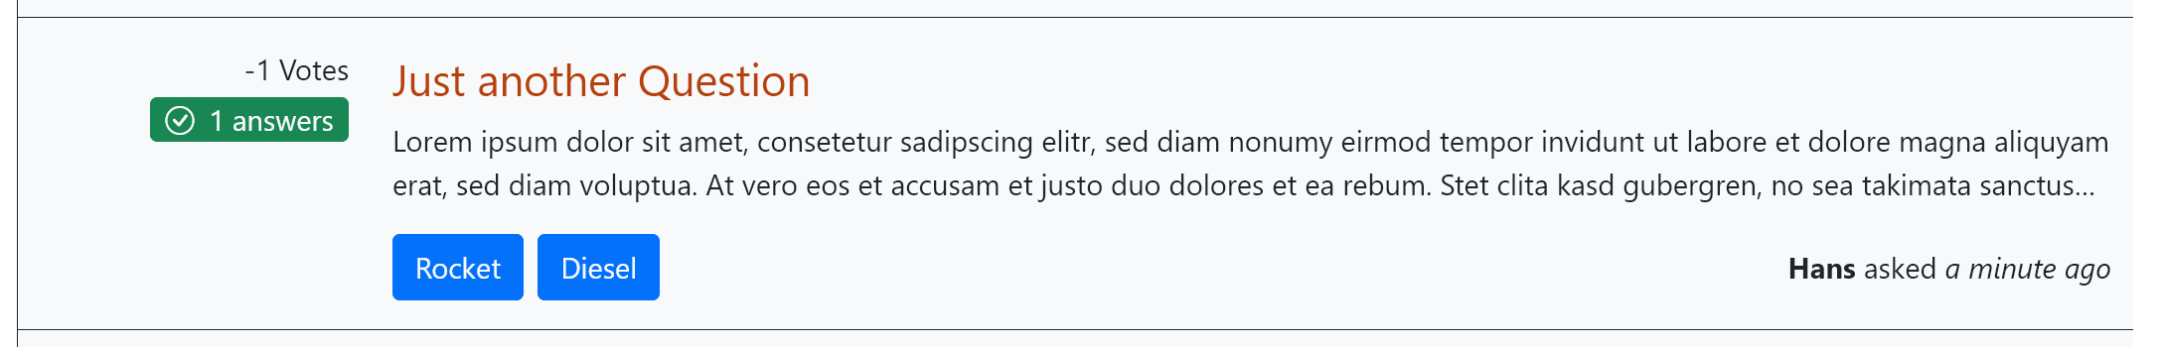
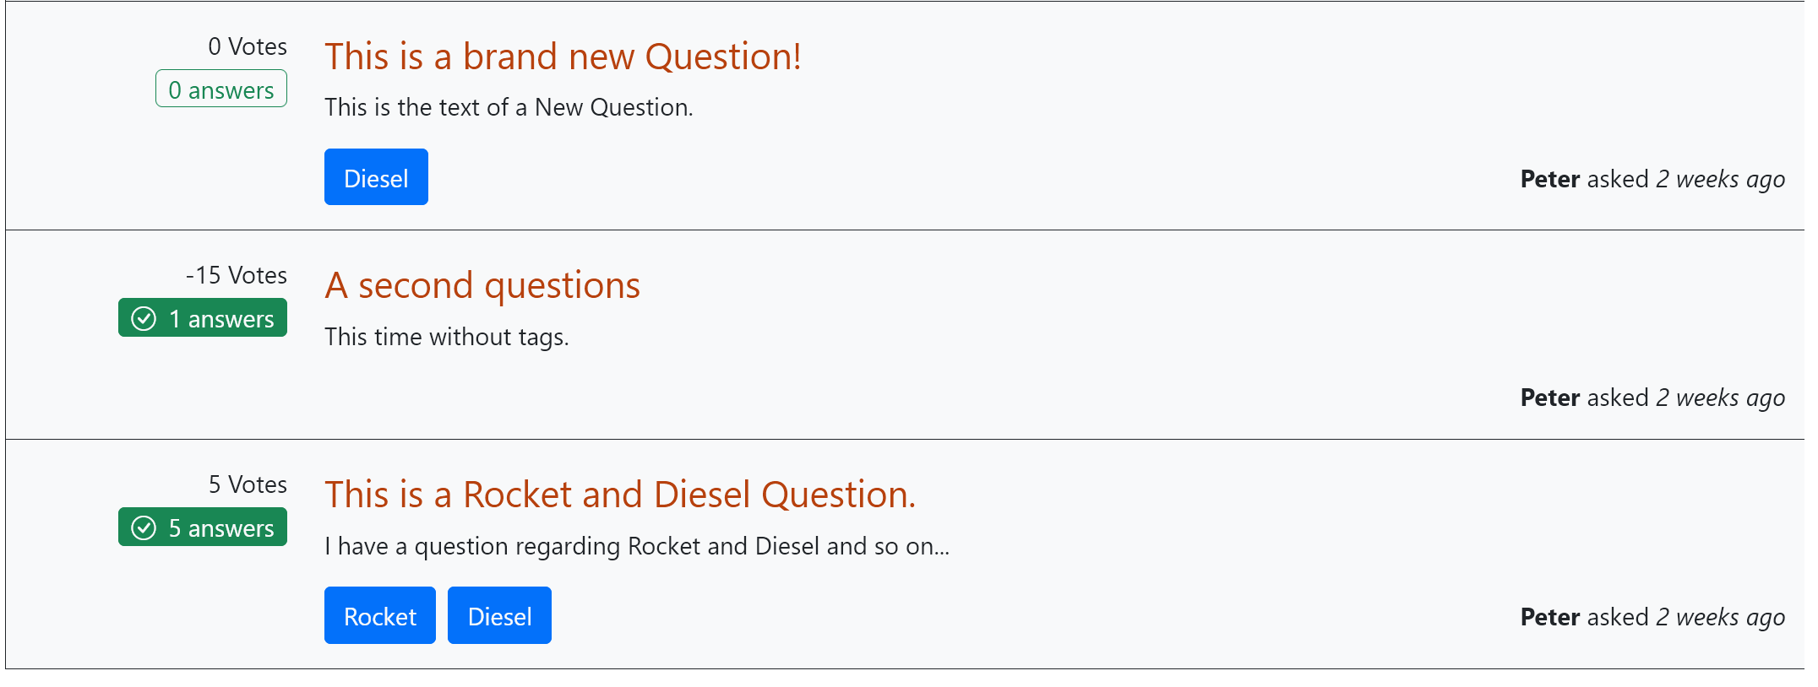
Handlebars
Why do we need a templating Engine?
⁞
Notes:
Can be used for any text based file.
Should be used for HTML

Slide 25
Handlebars by Example
questions.html.hbs
{{#each questions}} <div class=“…"> <div class=“…"> <div>{{score}} Votes</div> {{#if answered}} <div class=“…"><i class="bi-check-circle me-2"></i>{{num_answers}} answers</div> {{else}} <div class=“…">{{num_answers}} answers</div> {{/if}} </div> <div class=“…"> <a class=“…" href="/q/{{id}}">{{title}}</a> <div class=“…">{{text}}</div> <div class=“…"> {{#each tags}} <a class=“…" href="/t/{{name}}">{{name}}</a> {{/each}} <div class=“…"> <div><strong>{{author}}</strong> asked <em>{{to_duration time}}</em></div> </div> </div> </div> </div> {{/each}}
Notes:
Can be used for any text based file.
Should be used for HTML

Slide 26
Handlebars by Example
Target File Type
questions.html.hbs
{{#each questions}} <div class=“…"> <div class=“…"> <div>{{score}} Votes</div> {{#if answered}} <div class=“…"><i class="bi-check-circle me-2"></i>{{num_answers}} answers</div> {{else}} <div class=“…">{{num_answers}} answers</div> {{/if}} </div> <div class=“…"> <a class=“…" href="/q/{{id}}">{{title}}</a> <div class=“…">{{text}}</div> <div class=“…"> {{#each tags}} <a class=“…" href="/t/{{name}}">{{name}}</a> {{/each}} <div class=“…"> <div><strong>{{author}}</strong> asked <em>{{to_duration time}}</em></div> </div> </div> </div> </div> {{/each}}

Slide 27
Handlebars by Example
questions.html.hbs
Context
Context Reference
{{#each questions}} <div class=“…"> <div class=“…"> <div>{{score}} Votes</div> {{#if answered}} <div class=“…"><i class="bi-check-circle me-2"></i>{{num_answers}} answers</div> {{else}} <div class=“…">{{num_answers}} answers</div> {{/if}} </div> <div class=“…"> <a class=“…" href="/q/{{id}}">{{title}}</a> <div class=“…">{{text}}</div> <div class=“…"> {{#each tags}} <a class=“…" href="/t/{{name}}">{{name}}</a> {{/each}} <div class=“…"> <div><strong>{{author}}</strong> asked <em>{{to_duration time}}</em></div> </div> </div> </div> </div> {{/each}}
#[derive(Debug, Clone, Serialize)] struct QuestionsCtx { questions: Vec<DisplayQuestion>, }
#[derive(Serialize, Debug, Clone)] pub(crate) struct DisplayQuestion { pub(crate) id: i32, pub(crate) author: String, pub(crate) time: NaiveDateTime, pub(crate) score: i32, pub(crate) title: String, pub(crate) text: String, pub(crate) tags: Vec<Tag>, pub(crate) num_answers: i64, pub(crate) answered: bool, }

Slide 28
Handlebars by Example
It’s all about Helpers!
questions.html.hbs
Context
{{#each questions}} <div class=“…"> <div class=“…"> <div>{{score}} Votes</div> {{#if answered}} <div class=“…"><i class="bi-check-circle me-2"></i>{{num_answers}} answers</div> {{else}} <div class=“…">{{num_answers}} answers</div> {{/if}} </div> <div class=“…"> <a class=“…" href="/q/{{id}}">{{title}}</a> <div class=“…">{{text}}</div> <div class=“…"> {{#each tags}} <a class=“…" href="/t/{{name}}">{{name}}</a> {{/each}} <div class=“…"> <div><strong>{{author}}</strong> asked <em>{{to_duration time}}</em></div> </div> </div> </div> </div> {{/each}}
#[derive(Debug, Clone, Serialize)] struct QuestionsCtx { questions: Vec<DisplayQuestion>, }
Block Helper
#[derive(Serialize, Debug, Clone)] pub(crate) struct DisplayQuestion { pub(crate) id: i32, pub(crate) author: String, pub(crate) time: NaiveDateTime, pub(crate) score: i32, pub(crate) title: String, pub(crate) text: String, pub(crate) tags: Vec<Tag>, pub(crate) num_answers: i64, pub(crate) answered: bool, }

Slide 29
Handlebars by Example
It’s all about Helpers!
questions.html.hbs
Context
{{#each questions}} <div class=“…"> <div class=“…"> <div>{{score}} Votes</div> {{#if answered}} <div class=“…"><i class="bi-check-circle me-2"></i>{{num_answers}} answers</div> {{else}} <div class=“…">{{num_answers}} answers</div> {{/if}} </div> <div class=“…"> <a class=“…" href="/q/{{id}}">{{title}}</a> <div class=“…">{{text}}</div> <div class=“…"> {{#each tags}} <a class=“…" href="/t/{{name}}">{{name}}</a> {{/each}} <div class=“…"> <div><strong>{{author}}</strong> asked <em>{{to_duration time}}</em></div> </div> </div> </div> </div> {{/each}}
#[derive(Debug, Clone, Serialize)] struct QuestionsCtx { questions: Vec<DisplayQuestion>, }
If (Block) Helper
#[derive(Serialize, Debug, Clone)] pub(crate) struct DisplayQuestion { pub(crate) id: i32, pub(crate) author: String, pub(crate) time: NaiveDateTime, pub(crate) score: i32, pub(crate) title: String, pub(crate) text: String, pub(crate) tags: Vec<Tag>, pub(crate) num_answers: i64, pub(crate) answered: bool, }

Slide 30
Handlebars by Example
It’s all about Helpers!
questions.html.hbs
Context
{{#each questions}} <div class=“…"> <div class=“…"> <div>{{score}} Votes</div> {{#if answered}} <div class=“…"><i class="bi-check-circle me-2"></i>{{num_answers}} answers</div> {{else}} <div class=“…">{{num_answers}} answers</div> {{/if}} </div> <div class=“…"> <a class=“…" href="/q/{{id}}">{{title}}</a> <div class=“…">{{text}}</div> <div class=“…"> {{#each tags}} <a class=“…" href="/t/{{name}}">{{name}}</a> {{/each}} <div class=“…"> <div><strong>{{author}}</strong> asked <em>{{to_duration time}}</em></div> </div> </div> </div> </div> {{/each}}
#[derive(Debug, Clone, Serialize)] struct QuestionsCtx { questions: Vec<DisplayQuestion>, }
#[derive(Serialize, Debug, Clone)] pub(crate) struct DisplayQuestion { pub(crate) id: i32, pub(crate) author: String, pub(crate) time: NaiveDateTime, pub(crate) score: i32, pub(crate) title: String, pub(crate) text: String, pub(crate) tags: Vec<Tag>, pub(crate) num_answers: i64, pub(crate) answered: bool, }
Custom Inline Helper

Slide 31
Stitching it Together
frontend.rs
#[get("/")] pub(crate) async fn index(user: Option<Login>, conn: DbConn) -> Result<Template, (Status, String)> {
let questions = conn.newest_questions().await?;
Ok(Template::render(
"questions",
QuestionsCtx { questions, }, ))
}
Let‘s have some fun with it!

